Slide 1


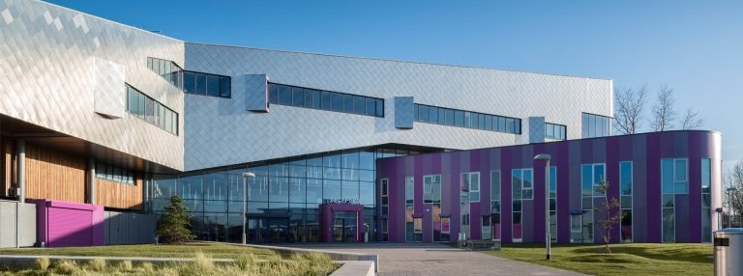

RECRUITMENT PACK
Learning Support Assistant
Salary Range: Grade 3

Slide 2
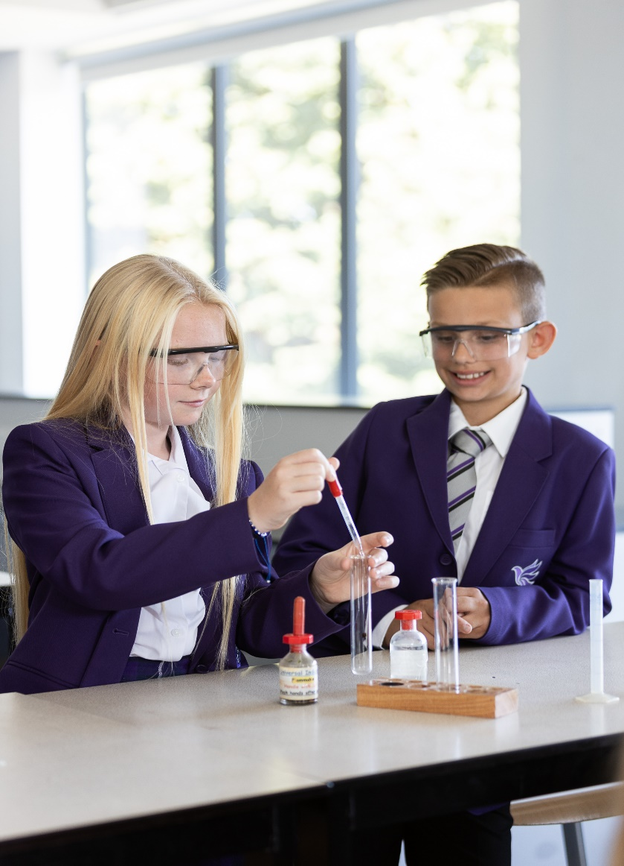


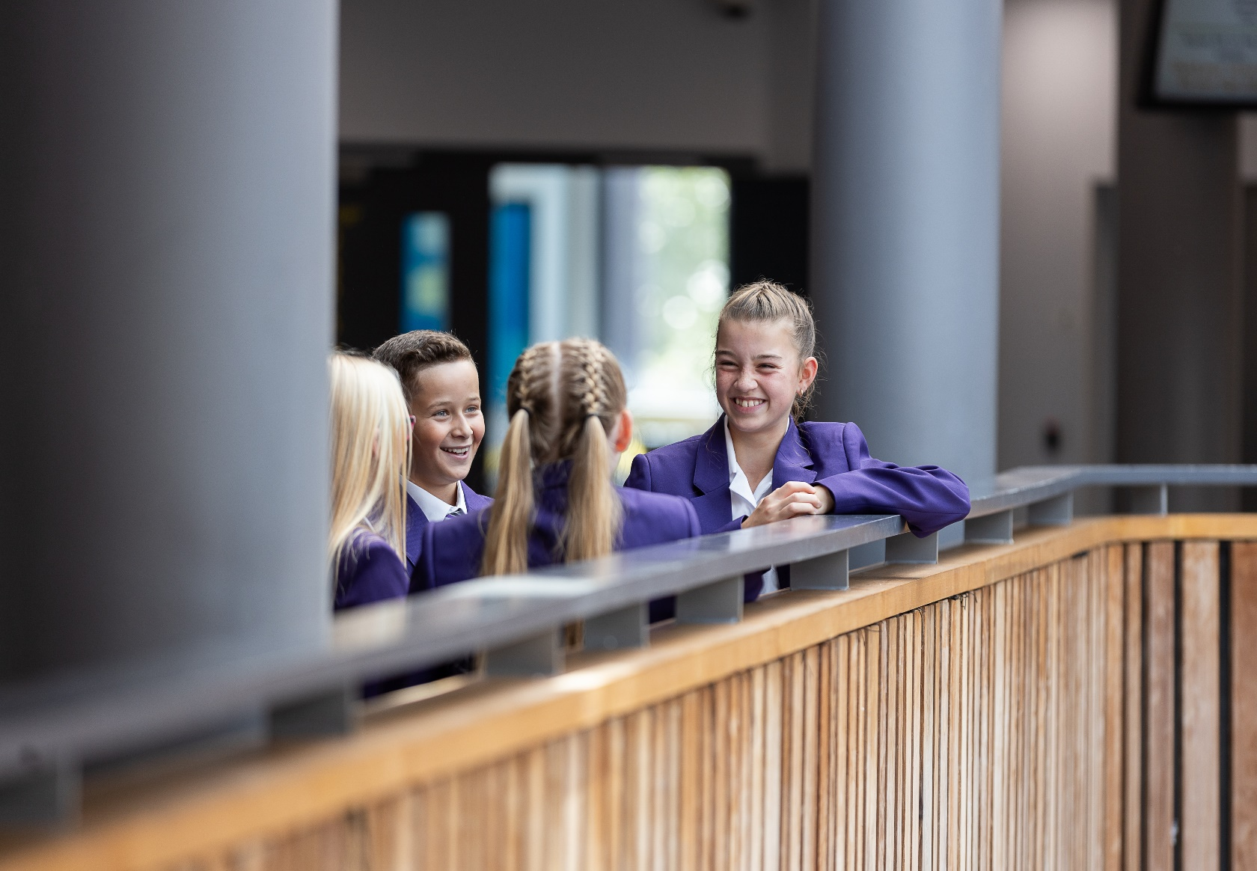


“Teachers have high expectations of what pupils and students should achieve. They care about pupils and help them to do their best.”
Ofsted December 2022
“Pupils at this school, including those in the sixth form, benefit from a broad and ambitious curriculum”
Ofsted December 2022

Slide 3
CONTENTS
4. | Letter from our CEO
5. | Letter from the Headteacher
6. | Information about the Academy of St Nicholas
7. | Mission and Values
8. | Application and Interview Process
10. | Job Vacancy
12. | Job Description
18. | Person Specification

Slide 4
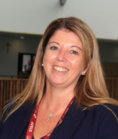
LETTER FROM OUR CEO
Thank you for your interest in a position within the All Saints Multi Academy Trust.
All Saints Multi Academy Trust is at an exciting time in its development and is committed to its mission of ensuring that all young people achieve and are successful.
All Saints Multi Academy Trust is a joint Catholic and Church of England trust with our Christian values driving all decision making, always in the best interests of our children and young people.
You will be joining a values driven, inspirational and ambitious organisation, so we are looking for an Outstanding candidate who can provide the highest quality of service to the Academy of St. Nicholas and the Trust.
You will be committed to supporting our Christian and educational vision, providing strong leadership and supporting colleagues in ways which bring out their potential.
Ultimately you will ensure that the best possible outcomes for our people are achieved.
Yours faithfully
Heather Duggan CEO

Slide 5
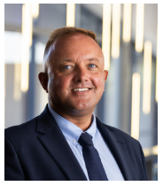
LETTER FROM THE
HEADTEACHER
Mr G Lloyd
Headteacher

Slide 6

ACADEMY INFORMATION
The Academy of St. Nicholas is a unique joint Catholic and Church of England Academy at the heart of our local community and we are proud to be part of the All Saints Multi-Academy Trust.
We are blessed with state-of-the-art facilities which enable us to illuminate all aspects of education to the young people we serve.
The Academy of St Nicholas is an ambitious and progressive 11-18 Academy in Liverpool with approximately 950 students on roll.
The Academy is focused upon driving standards of achievement rapidly and this makes it a dynamic and exciting place to work as evidenced by our recent Section 5 Ofsted inspection which can be found here.
The Academy of St Nicholas is committed to ensuring that every student makes the most of their potential, ensuring that every person within our community can flourish & thrive.
The Academy concentrates on providing the highest quality of teaching, with bespoke CPD for all staff to support this, the best possible student support, and the most appropriate and innovative curriculum.
Our Academy is part of the All Saints Multi Academy Trust. There is a trust wide commitment to improve, accelerate and enable ambitious life goals amongst all young people in our academies living out the core values of ASPIRATION, INCLUSION & SERVICE.
The successful candidate must share these values and have the skills, expertise, and determination to translate them into reality.
You will join a school and trust committed to your personal development with access to 21st Century CPD opportunities so that you can continue to grow as a professional.

Slide 7




OUR MISSION AND VALUES
Our Mission
Our mission is that the The Academy of St Nicholas equips all members of its learning community with the values, skills and attributes they will need for personal success and
well-being in a multi-cultural society and global economy.
Our Values
The Academy of St Nicholas is a welcoming, calm and purposeful Academy where everyone feels valued, supported and challenged. Our Academy is a place where students’ desire for learning and achievement is met by the passionate commitment of all the staff to the The Academy of St Nicholas
Respect
Ambition
Resilience
Compassion

Slide 8
APPLICATION AND INTERVIEW PROCESS
After the closing date, shortlisting will be conducted by a panel. Please read the job description and person specification carefully before writing your application.
All candidates invited to interview must bring the following documents:
Documentary evidence of right to work in the UK
Documentary evidence of identity that will satisfy DBS requirements such as current driving licence including a photograph and/or passport and/or full birth certificate
Documentary proof of current name and address (i.e utility bill, financial statement etc dated within the last three months)
Where appropriate any documentation evidencing changes of name
Documents confirming any educational or professional qualifications that are necessary or relevant for the post
Please note that originals of the above are necessary. Photocopies of certified copies are not sufficient.
References and Pre-Employment Checks
We will seek references for candidates who have been successful at shortlisting and have been invited for interview. We will seek references prior to attending for the interview. We may approach previous employers for information to verify experience or qualifications before interview. In addition to candidates’ ability to perform the duties of the post, the interview will also explore issues relating to safeguarding and promoting the welfare of children, including:
Motivation to work with children and young people
Ability to form and maintain appropriate relationships and personal boundaries with children and young people
Emotional resilience in working with challenging behaviours
Attitudes to use of authority and maintaining discipline
Conditional offer: Pre-employment Checks
Any offer to successful candidates will be conditional upon:
Verification of right to work in the UK
Receipt of at least two satisfactory references (if these have not already been received)
Verification of identity checks and qualifications
Section 128 check
Prohibition order
Satisfactory DBS Disclosure and Barred List Check
Verification of professional status such as QTS status, NPQH (where required)
Completion of Employee Health Declaration
Where the successful candidate has worked or been resident overseas in the previous ten years, such checks and confirmations as may be required in accordance with statutory guidance.

Slide 9
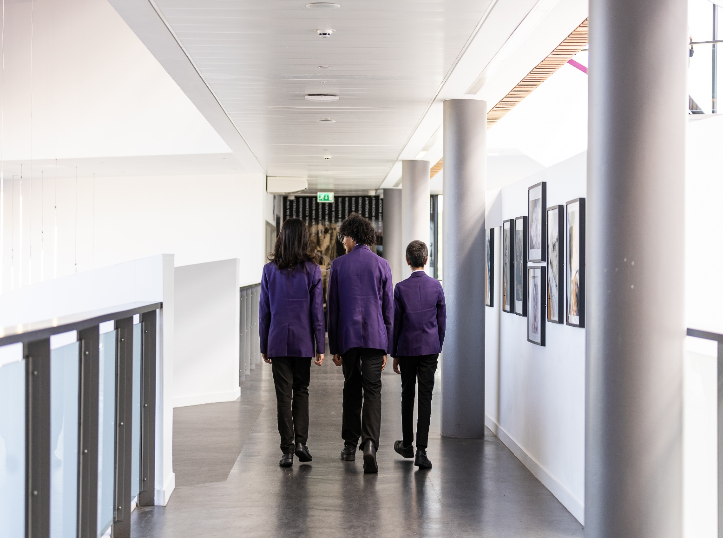
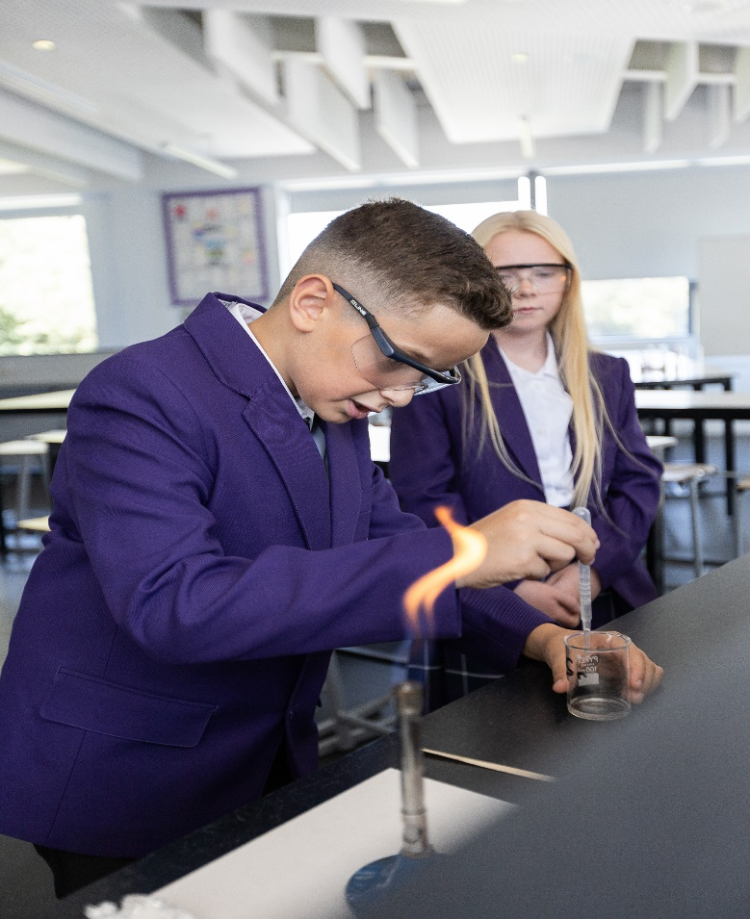

“Leaders have taken the school on a journey of improvement and remain ambitious for it.”
Ofsted December 2022
“Leaders have taken the school on a journey of improvement and remain ambitious for it.”
Ofsted December 2022

Slide 10
JOB VACANCY
Role: Learning Support Assistant
Salary Range: Grade 3, scale 5-9, salary £20,562-£21,979
Contract: 35 hours per week, 39 weeks per year /Permanent
Start Date: February 2024 or sooner
Applications are invited for an enthusiastic and ambitious Learning Support Assistant to join our team.
We are determined that the successful candidate will have:
An understanding of the SEND Code of Practice
Experience in supporting students with Special Educational Needs and Disabilities and improving their outcomes
A passion for working with young people
A passion for making a difference for young people in the city of Liverpool
Closing date for applications: Friday 12th January 2024
Interview date: Friday 19th January 2024
Application packs are available on the Trust website at www.allsaintsmat.org/vacancies.
Completed application forms should be forwarded to recruitmentapplications@allsaintsmat.org
The Academy is committed to safeguarding and promoting the welfare of children and young people and expects all staff and volunteers to share this commitment. This post is subject to an Enhanced DBS Check.
The Trust is an equal opportunities employer.

Slide 11
JOB DESCRIPTION
Job Title:
Learning Support Assistant
Grade and Salary:
Grade 3
Reporting to:
Learning Support Coordinator
Contract Type:
Full Time / Permanent
Responsible for:
No Line Management responsibility
To be responsible for
Supporting learning in a designated class or with a designated group of students. Core Responsibilities and Tasks Provide learning activities for classes/individuals under the professional direction and supervision of a qualified teacher in order to progress students’ learning. Assess, and report on development, progress and attainment as agreed with the teacher. Monitor and record student responses and learning achievements, drawing any problems which cannot be resolved easily to the attention of the teacher. Participate in planning and evaluation of learning activities with the teacher, writing reports and records as required. Support learning by selecting appropriate resources/methods to facilitate agreed learning activities. Provide particular and skilled support to all students in a particular learning area from within the overall national curriculum. Be involved in planning, organising and implementing SEN Support Plans, including attendance at, and contribution to, reviews. Consult with children and their families and carers and other adults as directed.

Slide 12
JOB DESCRIPTION
Academy Ethos
Promote the Academy as an inclusive institution with Christian values, serving the local community and reflecting the approach of the Church of England and the Catholic Church to education. Implement the Academy Improvement Plan to meet the objectives set out in the Funding Agreement. Help to meet strategic targets for the Academy set by the Governing Body. Support and facilitate access to the curriculum for all learners to meet the objectives in the Academy Improvement Plan and targets set by the Secretary of State and Governing Body Enable the Academy to be rooted at the heart of the community. Develop links as appropriate with partners, schools, FE and HE establishments, sponsors and the Connexions service, thereby ensuring greater opportunities for the young people in the Academy particularly in the areas of work experience and study support.
Communication & Liaison
Communicate effectively with the parents of students as appropriate. Where appropriate, communicate and co-operate with persons or bodies outside the Academy. Follow agreed policies for communications in the Academy.

Slide 13
PERSON SPECIFICATION
Qualifications and Professional Development | Essential (E) Desirable (D)
5 GCSE passes A* - C or equivalent | E
NVQ Level 2 or equivalent in teaching assistance | D
Experience, Knowledge and Understanding
General understanding of national curriculum | E
Understanding of basic learning programmes and techniques | E
Experience of working with secondary aged students | E
Knowledge of classroom roles and responsibilities | E
Understanding of health and safety in the workplace | D
Skills and Attributes
Good interpersonal skills | E
Good team player | E
Commitment to supporting students and colleagues | E
Good written and oral communication skills | E
Able to manage classroom activities safely | E
Ability to organise classroom resources | E
Good organisational skills | E
Able to be flexible and use initiative | E
Able to relate well to children | E
Good time management | E
Ability to stay calm under pressure | E
Willing to undertake training | E
Ability to relate to parents/carers | E
Patience and enthusiasm | E
Approach to Work
Commitment to the Academy’s Christian ethos | E

Slide 14


The Academy of St Nicholas
51 Horrocks Avenue
Liverpool
L19 5NY
Tel: 0151 230 2570
Email: info@astn.uk
The Academy of St Nicholas is proud to be a member of the All Saints Multi Academy Trust.
All Saints Multi Academy Trust is the operating name for the The Liverpool Joint Catholic and Church of England Academies Trust (Company Number 07007398)
51 Horrocks Avenue, Liverpool, L19 5NY, England.
PROUD TO BE PART OF

