Slide 1
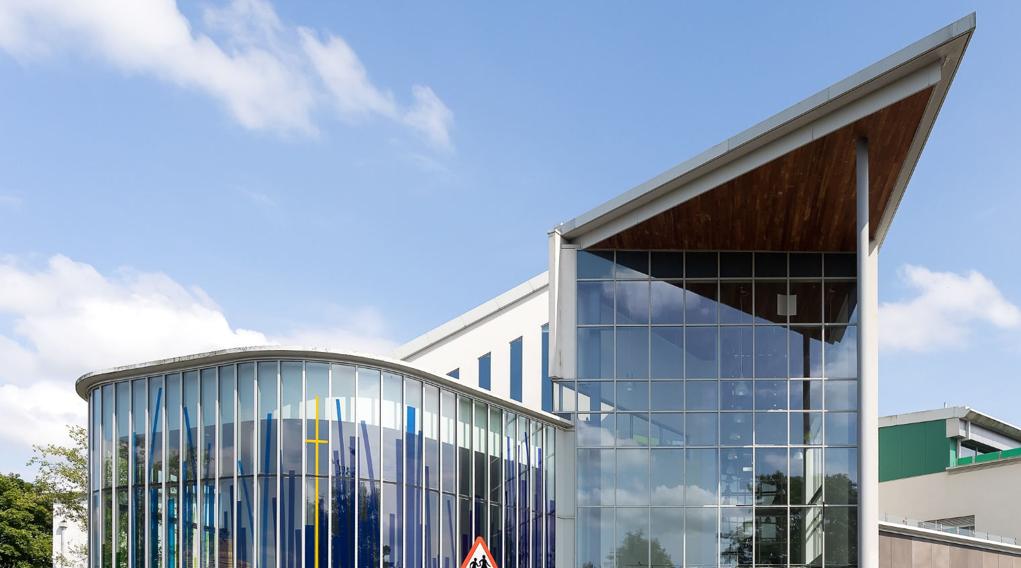
RECRUITMENT PACK
Teacher of Science
Salary Range: MPS/UPS

Slide 2
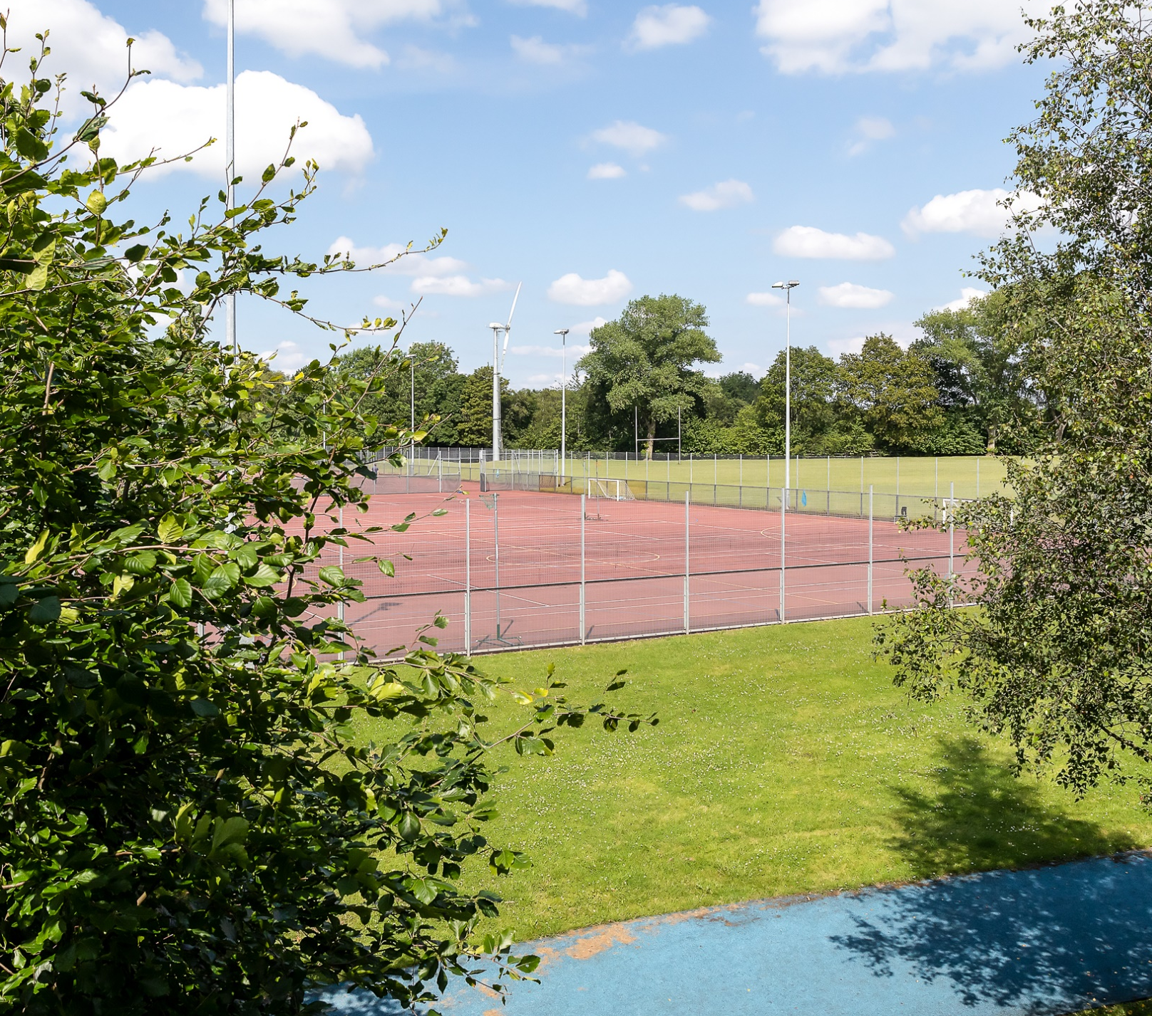
Governors and leaders have steered Hope Academy’s re-invigoration of its definition and living of Catholic and Anglican Christian life according to the school’s owned and shared mission and values.
Section 48 Inspection 2018
Staff have high expectations of pupils. They ensure that the school’s ethos of ‘respect, courage and ambition’ is the day-to-day experience for pupils at Hope Academy. Pupils from all backgrounds are welcome and treated equally and fairly.
Ofsted September 2021

Slide 3
CONTENTS
4. | Letter from our CEO
5. | Letter from the Principal
6. | Information about Hope Academy
7. | Mission and Values
8. | Application and Interview Process
10. | Job Vacancy
12. | Job Description
18. | Person Specification

Slide 4
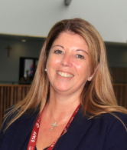
Letter from our CEO
Thank you for your interest in a position within the All Saints Multi Academy Trust.
All Saints Multi Academy Trust is at an exciting time in its development and is committed to its mission of ensuring that all young people achieve and are successful.
All Saints Multi Academy Trust is a joint Catholic and Church of England trust with our Christian values driving all decision making, always in the best interests of our children and young people.
You will be joining a values driven, inspirational and ambitious organisation, so we are looking for an Outstanding candidate who can provide the highest quality of service to Hope Academy and the Trust.
You will be committed to supporting our Christian and educational vision, providing strong leadership and supporting colleagues in ways which bring out their potential. Ultimately you will ensure that the best possible outcomes for our people are achieved.
Yours faithfully
Heather Duggan
CEO

Slide 5
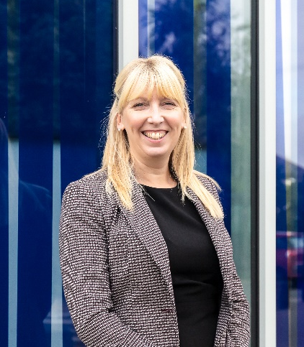
Letter from our Principal
I am delighted that you are considering an application for a post at Hope Academy. The continuing development of our Academy has been reflected in its popularity within the borough as a choice for young people’s education.
As a Christian academy, it is important not only to educate our students, but also to help them to develop into responsible and caring adults who will be guided by sound moral values. We have a clear shared vision of what we want to achieve at Hope Academy, and we are an open and caring community supported by a network of strong relationships, which are at the heart of everything we do here.
A rounded education relies on experiences as well as a knowledge-rich curriculum, and Hope Academy students have plenty of opportunities to go on educational visits, thoroughly enriching their academic years. Our team makes every effort to liaise closely with the world of business and commerce, so that young people can make informed choices about their futures. One of our initiatives is Hope Opportunity Trust, a link with some of England’s top public schools which has resulted in a number of students gaining all expenses paid scholarships to study their A levels at schools which are renowned throughout the world.
All of us at Hope Academy are determined to drive the academy forward and strive to be the best versions of ourselves. We will continue to ‘Serve one another through Love’ and welcome applications from talented practitioners who wish to join us in our pursuit to excellence.
Yours faithfully
Marie Adams
Principal

Slide 6
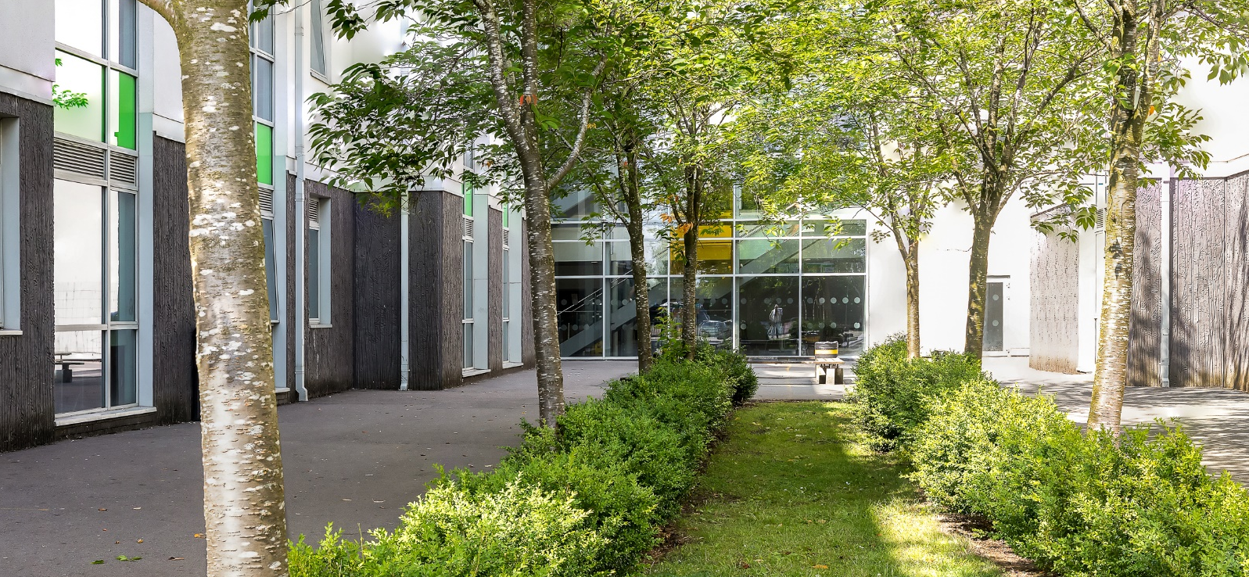
Academy Information
Hope Academy is an 11-16 Christian Academy which stands at the centre of our local community. Serving the Archdiocese and Diocese of Liverpool, we are inspired by Jesus’ example of servant leadership. Therefore, at Hope Academy we follow in the footsteps of Christ in everything that we do. Our mission is to deliver high quality education by working together to inspire excellence guided by Christian values. As a Christian Academy, we consider the spiritual and social development of our young people to be as important as their academic success. Jesus asked us to love one another as he loved us, so we ensure that we celebrate and develop the uniqueness of every individual. Guided by the Holy Spirit, we live by our core values of
Respect - Courage - Ambition - Hope
These values ensure that - as a community - we care for ourselves and one another.
Our team of teachers and support staff are dedicated to making a difference to the lives of our students by ‘serving one another through love’ and we do this by offering a wide, varied and challenging curriculum throughout all key stages. Our students engage with a range of extra-curricular activities in order to develop their wider passions and enhance their Academy life. We believe that all our students have something wonderful to offer and we work passionately to nurture these talents, making sure that all members of our Hope Community have the opportunity to live our vision of serving others through love.
Hope Academy enjoys a magnificent building surrounded by spacious grounds. There is every opportunity for students to succeed, as we have outstanding facilities which include advanced science laboratories, a recording studio and photography studio, a fully equipped technology suite and a state-of-the-art gym. Students benefit from spacious and stylish surroundings and can enjoy social interaction in both indoor and outdoor situations.

Slide 7
Our Mission, Vision & Values
At the core of our Academy’s actions is our central mission: ‘Working together to inspire excellence, guided by Christian Values’. It is through this mission that the community live our Core Values of Respect, Courage and Ambition. By serving each other through love we show respect to our neighbour, courage to be the best version of ourselves, ambition to help all those who come into our lives and hope to make the world a better place through our actions.
The personal and character development of our students is central to how we nurture and support our community. We are very proud of the Hope Inspire Programme which is delivered daily during form time and is underpinned by our core values. During this 5-year learning programme, students regularly engage in critical discussions and activities which explore our Christian Ethos, as well as addressing statutory requirements linked to Personal Health and Social Education (PHSE); Spiritual, Moral, Social and Cultural (SMSC); and Careers Education, Information, Advice and Guidance (CEIAG). The Inspire Programme is designed to prepare students to graduate from Hope Academy as young independent learners who are secure in their place in the world, who know themselves and their ambitions for the future and how to achieve them.
Our Vision:
Hope Academy is a family, guided by Christian love, in which we serve our whole community with empathy and compassion, helping every member to flourish so all can pursue a rich and full life.
‘Serve one another through love’ (Galatians 5:13)
Our Mission:
Working together to inspire excellence guided by Christian values.
‘Do to others as you would have them do to you.’ (Luke 6:31)
Our Values:
RESPECT: ‘Love your neighbour as yourself’ (Matthew 22:39)
COURAGE: ‘Be strong and courageous. Do not be frightened, and do not be dismayed, for the Lord your God is with you wherever you go.’ (Joshua 1:9)
AMBITION: [Jesus said] “I am among you as the one who serves” (Luke 22:27)
HOPE: ‘I will put my hope in God’ (Psalm 42:5)

Slide 8
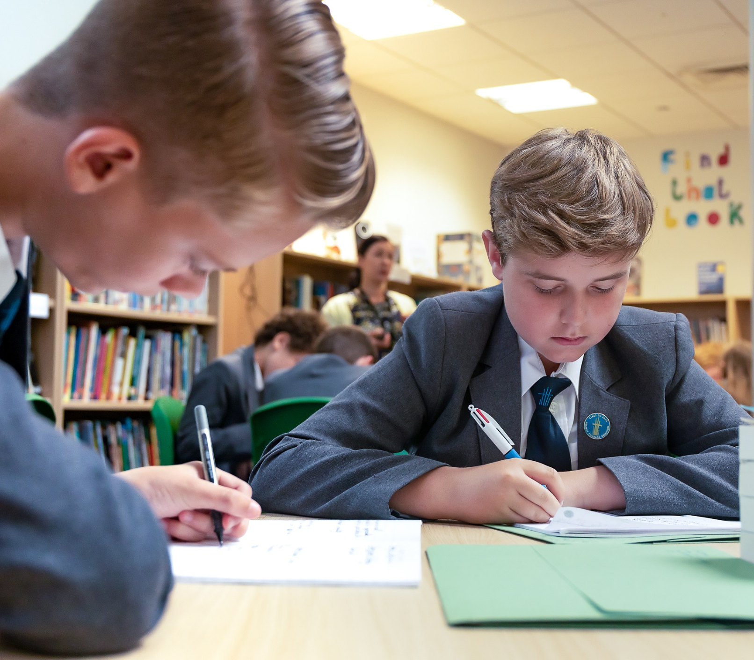
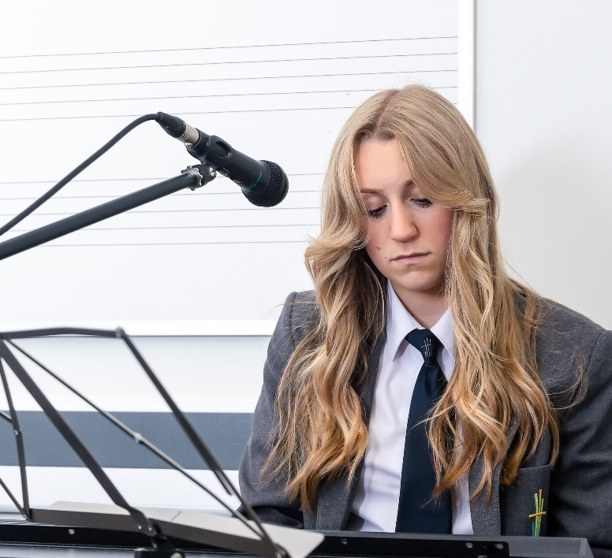
Students respond with pride in their school, because it gives them security, happiness and an overall spirit of belonging. They understand school to be a place where they can do hard-work and be well supported and encouraged, They readily identify with the school’s core values of “Respect, Courage and Ambition.
Section 48 Inspection 2018

Slide 9
Application and Interview Process
After the closing date, shortlisting will be conducted by a panel. Please read the job description and person specification carefully before writing your application. All candidates invited to interview must bring the following documents:
Documentary evidence of right to work in the UK.
Documentary evidence of identity that will satisfy DBS requirements such as current driving licence including a photograph and/or passport and/or full birth certificate.
Documentary proof of current name and address (i.e utility bill, dated within the last three months).
Where appropriate any documentation evidencing changes of name.
Documents confirming any educational or professional qualifications that are necessary or relevant for the post.
Please note that originals of the above are necessary. Photocopies of certified copies are not sufficient.
References and Pre-Employment Checks
We will seek references for candidates who have been successful at shortlisting and have been invited for interview. We will seek references prior to attending for the interview. We may approach previous
employers for information to verify experience or qualifications before interview. In addition to candidates’ ability to perform the duties of the post, the interview will also explore issues relating to safeguarding and promoting the welfare of children, including:
Motivation to work with children and young people
Ability to form and maintain appropriate relationships and personal boundaries with children and young people
Emotional resilience in working with challenging behaviours
Attitudes to use of authority and maintaining discipline
Conditional offer: Pre-employment Checks
Any offer to successful candidates will be conditional upon:
Verification of right to work in the UK
Receipt of at least two satisfactory references (if these have not already been received)
Verification of identity checks and qualifications
Section 128 check
Prohibition order
Satisfactory DBS Disclosure and Barred List Check
Verification of professional status such as QTS status, NPQH (where required)
Completion of Employee Health Declaration
Where the successful candidate has worked or been resident overseas in the previous ten years, such checks and confirmations as may be required in accordance with statutory guidance.

Slide 10
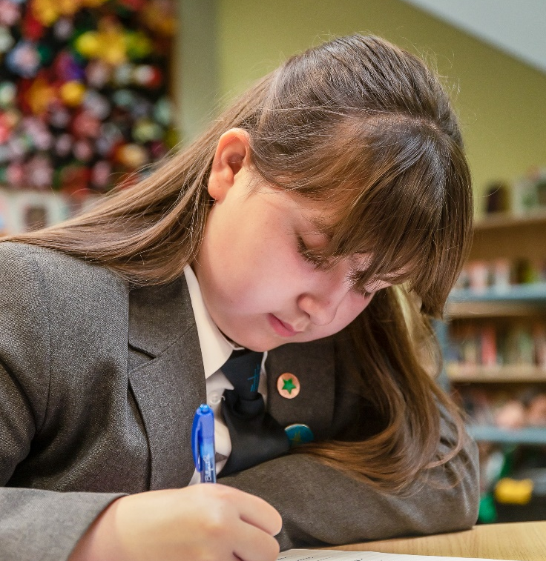
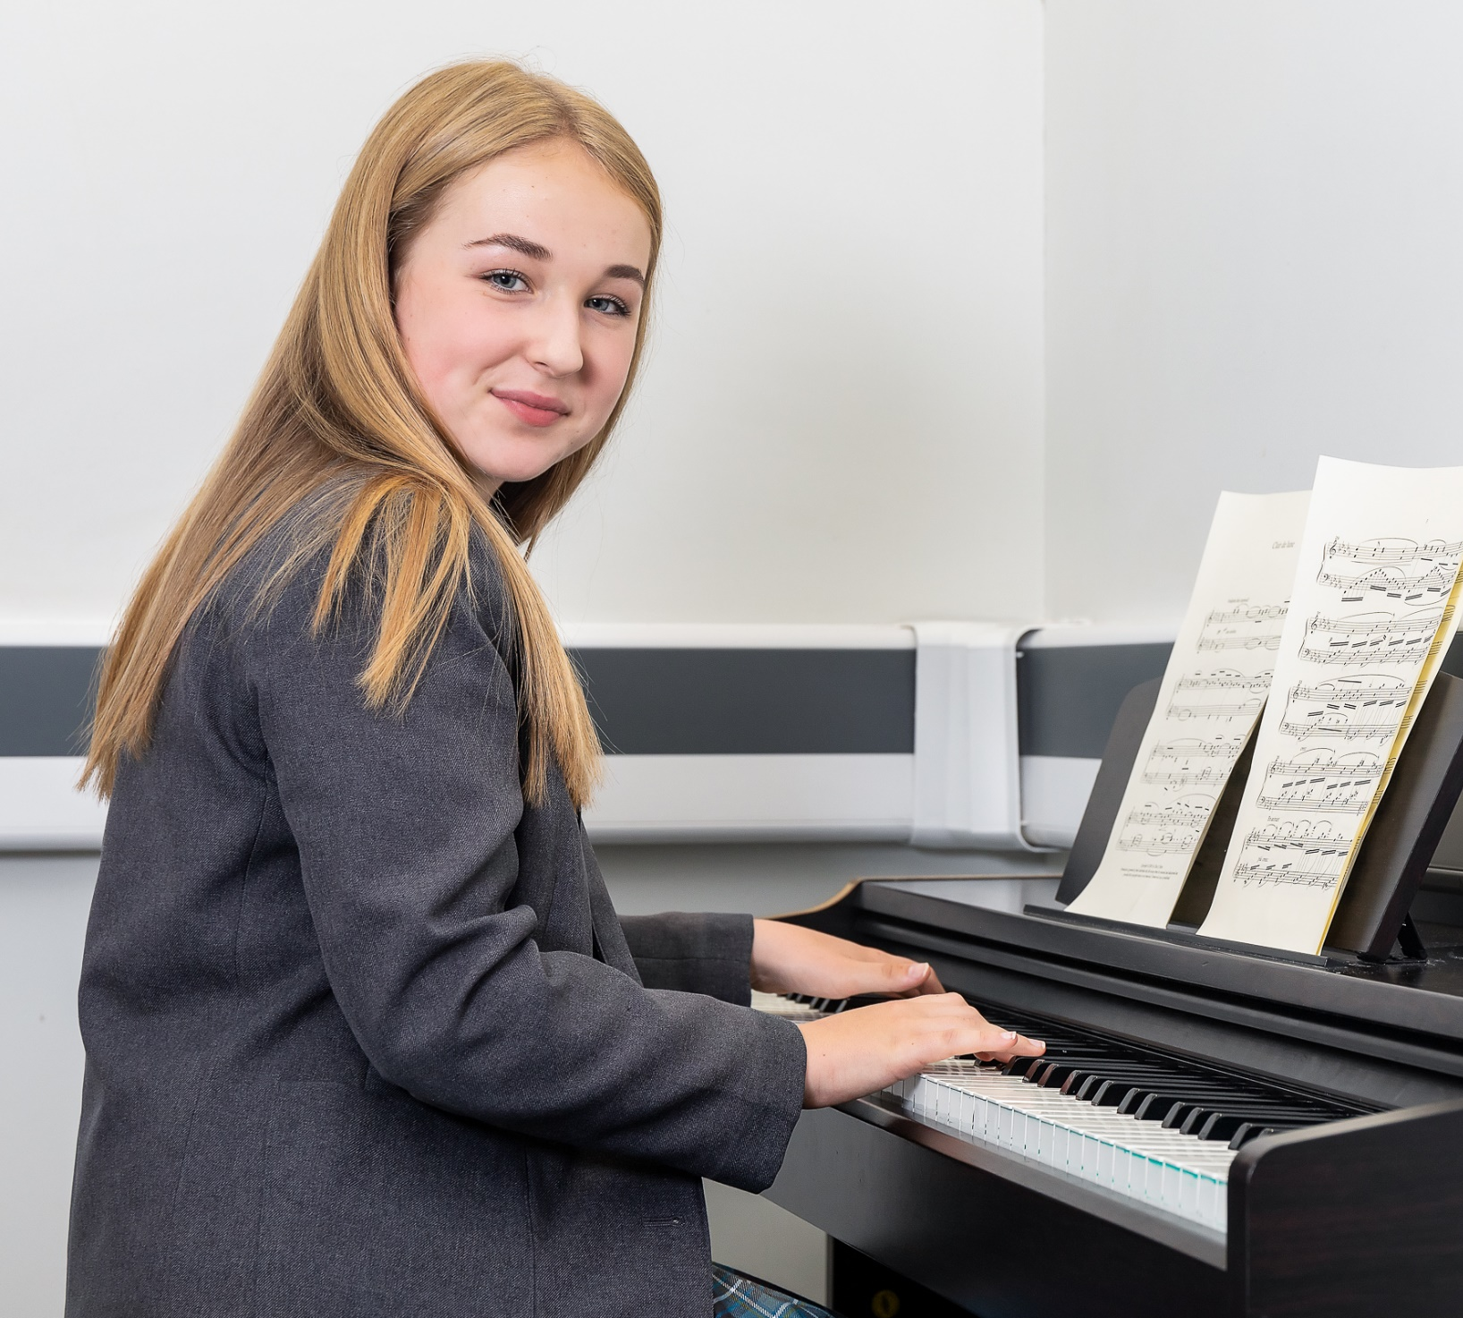
Staff successfully motivate pupils to behave well. Pupils enjoy a consistently calm and respectful environment. They can learn without interruption.
Ofsted September 2021
Pupils at Hope Academy extend their kindness beyond the school community. They willingly contribute to a range of local charities, including food banks and hospices. Ofsted September 2021

Slide 11
Vacancy Specific Information

Slide 12
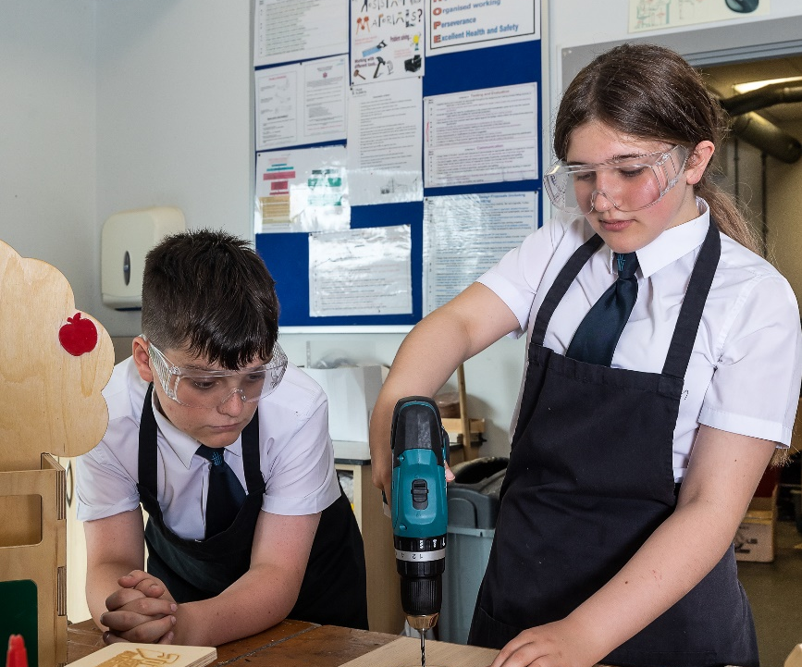
Leaders and governors show great care for pupils at Hope Academy. Their plans and actions are consistently centred on the best interests of pupils. They do what they can to use the views of pupils, and parents and carers to help improve the school.
Ofsted September 2021

Slide 13
Job Vacancy
Role: Teacher of Science
Salary Band: MPS/UPS
Contract: Permanent
Applications are invited for an enthusiastic and ambitious Teacher of Science to join our team.
We are determined that the successful candidate will have:
A passion for working with young people.
A passion for making a difference for young people lives.
Closing date for applications: Friday 10th May – 12 noon
Interview date: W/C 13th May
Application packs are available on the website at www.allsaintsmat.org/vacancies.
Completed application forms should be forwarded to recruitmentapplications@allsaintsmat.org
Our Trust is committed to safeguarding and promoting the welfare of children and young people and expects all staff and volunteers to share this commitment. Applicants will be required to undergo safeguarding checks appropriate to the post, including checks with past employers and the Disclosure and Barring Service (DBS). The post is exempt from the Rehabilitation of Offenders Act 1974 and the Trust is therefore permitted to ask job applicants to declare all convictions and cautions (including those which are "spent" unless they are "protected" under the DBS filtering rules) in order to assess their suitability to work with children.
The Trust is an equal opportunities employer.

Slide 14
Job Description
Job Title: Teacher of Science
Grade and Salary:
MPS/UPS
Reporting to: Head of Science
Contract Type: Permanent
Responsible for: Teaching Assistants and other staff working within your curriculum area.
As a Teacher you are responsible and accountable for raising and maintaining standards and ensuring high quality teaching and learning in your lessons. All teachers should maintain national professional standards of practice relevant to their role and grade. All Teachers at the Hope Academy should actively follow and promote the mission, policies and standards of the Academy which require: Supporting the ethos of the Academy which enables students to experience, develop and practise Christian values and living. Displaying an enthusiasm for your subject/s which motivates and engages students in your lessons. Displaying flair and creativity, enthusing and challenging groups of students. Plan and deliver high quality Teaching and Learning. Be fully committed to raising standards and improving the life chances of all students. Create a culture which celebrates the positive and encourages all kinds of achievement. Ensure, good communication and working in partnership with others. Support a caring and compassionate community, through being aware and responding to the needs of others. Promote a happy, stimulating and ordered environment within which children can grow, develop and thrive according to their talents and abilities. Be committed to high standards of professional co-operation and integrity.

Slide 15
Job Description
Responsibilities
Work collaboratively with other colleagues promoting co-operation and teamwork. Contribute to the effective operation of your curriculum team through accepting reasonable delegation of responsibilities and tasks. Where required, undertake a range of supervisory duties ensuring the safety and wellbeing of students in your care. To be a pro-active member of the Academy and ensure effective implementation of all policies and procedures. To contribute to the effective operational activities of the Academy, including attendance at meetings, events and activities as requested. Contribute to effective induction of ECTs and other staff new to your curriculum team. Contribute to the continuous improvement in standards, high quality evaluation and improvement planning throughout the Academy. To lead, support and encourage the highest possible standards of behaviour, learning, attainment and achievement. To manage resources creatively, effectively and efficiently to meet the priorities of the Academy. To celebrate success and implement strategies for continuing improvement. To maintain effective relationships with external agencies and associated schools and represent the Academy at external meetings. To manage resources creatively, effectively and efficiently to meet the priorities of the Academy.

Slide 16
Job Description
Corporate Responsibilities
The trust is committed to safeguarding and promoting the welfare of children and young people and expects all staff and volunteers to share this commitment.
To pursue and promote the achievement and integration of diversity and equality of opportunity throughout the Academy’s activities.
To plan, monitor and review health and safety within areas of personal control.
To participate in the Trust’s Performance Management process and engage in continuous professional development and networking to ensure that professional skills and knowledge are up to date.
To maintain high professional standards of attendance, punctuality, appearance, conduct and positive, courteous relations with students, parents, and colleagues.
Additional Information
The job purpose and key statements remain indicative and by no means exclusive. Given the evolving needs of the Academy, flexibility among staff is very important. All staff may be required to undertake other such reasonable duties as may be required from time to time in line with the grade of their post.
An Enhanced DBS Check will be requested on successful application to a position at the Trust.

Slide 17
Person Specification
Qualifications and Professional Development | Essential | Desirable
A degree in relevant subject. | ✓
PGCE (or equivalent teaching qualification). | ✓
Evidence of recent and relevant continuing professional development | ✓
Further completed professional study. |  | ✓
Knowledge and Understanding.
An excellent knowledge and understanding of your teaching subject/s | ✓
A good understanding of classroom management and behaviour strategies. | ✓
An excellent knowledge of up to date classroom pedagogy planning and assessment. | ✓
An understanding of the collection and use of data to inform targets and priorities, leading to improved outcomes. | ✓
A good knowledge and understanding of the role of a form tutor. | ✓
Knowledge and understanding of self-evaluation and quality assurance procedures | ✓
Evidence of achieving learning progress from classes within at least two different key stages. |  | ✓
Skills and Attributes
Evidence of a good level of teaching skills. | ✓
A good range of successful teaching and learning strategies. | ✓
The ability to create a safe and stimulating visual environment for the classroom. | ✓
The ability to create a learning environment which values and enables everyone equally. | ✓
A good level of numeracy skills. | ✓
A high level of written and oral communication skills | ✓
A good level of ICT skills. | ✓
Able to apply ICT as an effective teaching and learning strategy | ✓
Good interpersonal skills. | ✓
Able to prioritise and manage time effectively. | ✓
Experience of leading a curriculum development initiative and securing improvement. |  | ✓
Approach to Work
Commitment to the Academy’s Christian ethos | ✓

Slide 18
Hope Academy Ashton Road Newton-le-Willows
Merseyside WA12 0AQ Tel: 01744 671930
Email: enquiries@hopeacademy.org.uk
Hope Academy is proud to be a member of the All Saints Multi Academy Trust.
All Saints Multi Academy Trust is the operating name for the The Liverpool Joint Catholic and Church of England Academies Trust (Company Number 07007398).
51 Horrocks Avenue, Garston, Liverpool, L19 5NY.
PROUD TO BE PART OF

